Slide 1


Planning for Improving Throughput in Autonomous Intersection Management
Tsz-Chiu Au
Department of Computer Science
University of Texas at Austin
Department of Computer Science
The University of Texas at Austin

Slide 2
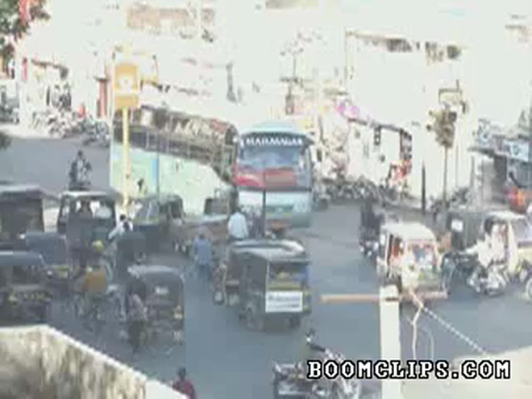
What can we learn from this video?
Notes:
Indian traffic, no traffic signals, no stop sign, all vehicles just pass through directly.
What is amazing is that vehicles can still manage to pass through the intersection safely.
But in reality – many traffic accidents.
But still there are somethings we can learn from this traffic

Slide 3
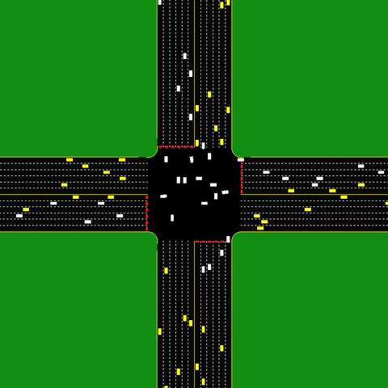
A Possible Solution to Traffic Congestion!
Notes:
Explain what is buffer. New video with buffer shown.
emphasize the *difference* from India video
- no accidents
- also, all the cars communicate with a reservation manager
- use video from new simulator and show buffers

Slide 4

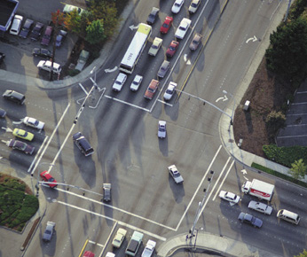
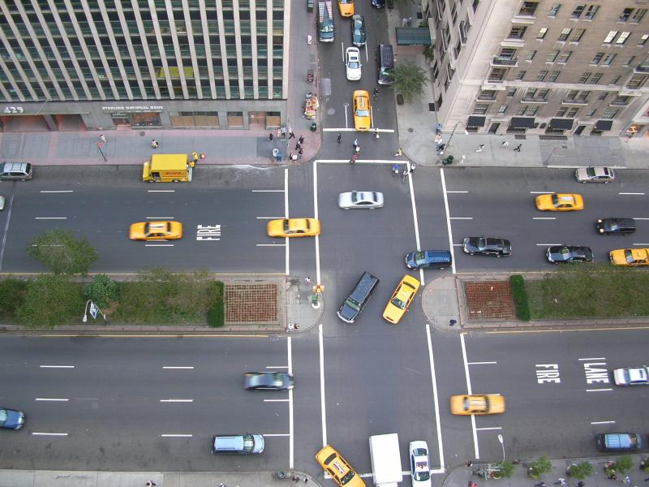
Autonomous Intersection
Fully autonomous vehicles are technologically feasible with current technology
the 2007 DARPA Urban Challenge
for sale within 5-20 years
But today’s transportation infrastructure are designed for human drivers only
Fail to utilize the full capacity of autonomous driving systems.
Autonomous Intersection Management (AIM)
proposed by Dresner and Stone (2008)
much more efficient than stop signs and traffic lights
Our goals:
Realistically evaluate the protocol with real autonomous vehicles
Improve the efficiency of the protocol.

Slide 5
Outline
An introduction to AIM
A platform for evaluating the AIM protocol using real autonomous vehicles.
Identify factors that affect the efficiency of AIM
Methods for improving the throughput of AIM.
Notes:
Need related work

Slide 6
aim
autonomous intersection management

Slide 7

The Reservation Idea
Vehicles call ahead to reserve a region of space-time on its trajectory in the intersection.
The intersection manager approves
or denies it.
Vehicles cannot enter intersection
without reservation.
Kurt Dresner and Peter Stone. A Multiagent Approach to Autonomous Intersection Management. JAIR 2008.
The autonomous vehicle said:
The intersection manager said:
I’m arriving at time t at velocity v and turns left.
Sounds good to me!

Slide 8
Intersection Manager
Grid-based collision detection
First Come, First Served (FCFS)
Time 4
Time 3
Time 2
Time 1

Slide 9
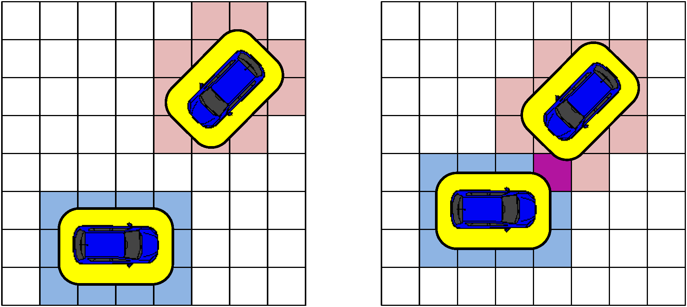
Intersection Manager
Approve the request only if the trajectory does not hit the trajectories of other vehicles.
Accept
Reject

Slide 10
FCFS vs. Stop Signs and Traffic Light
Traffic level: number of vehicles per second per lane
Average delay: increased travel time due to intersection and traffic

Slide 11
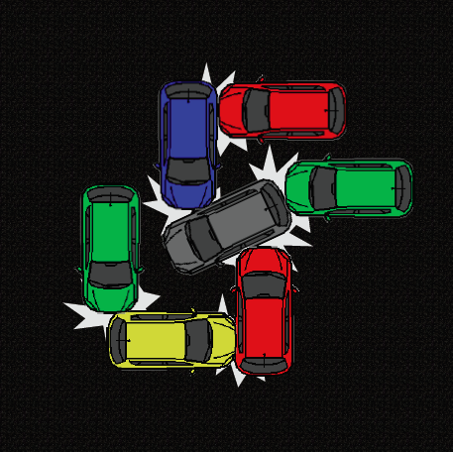
Is the protocol safe?

Slide 12
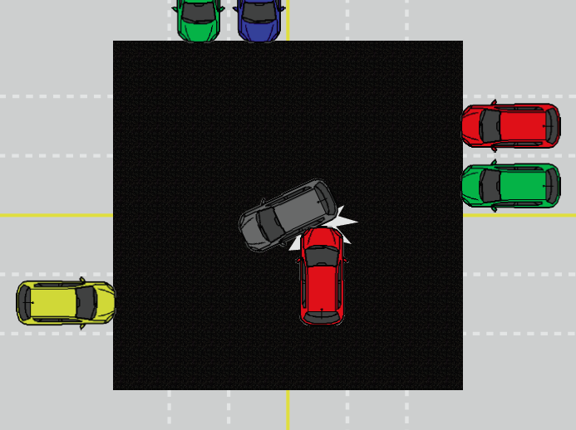
Safety Measures
STOP
If all autonomous vehicles follow the protocol,
Guarantee no collision.
Otherwise, collisions may occur.
The situation is just like running the red light today.
But we believe autonomous drivers can be made more reliable than human drivers.
Safety measures
No crash even if some messages were dropped.
A vehicle won’t enter an intersection if some messages are missing.
When a crash occurs, sends STOP messages to all vehicles nearby.
Avoid most collisions. But some are unavoidable.

Slide 13
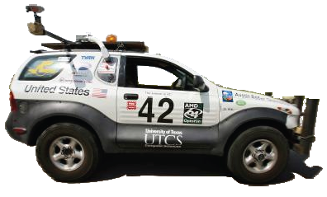
Sharing the Road with Human Drivers
Autonomous vehicles won’t displace manual-controlled vehicles in one day.
There is a long transition period.
Some people enjoy driving.
Autonomous vehicles and manual-controlled vehicles will share some, if not all, of the roads in the future.

Slide 14
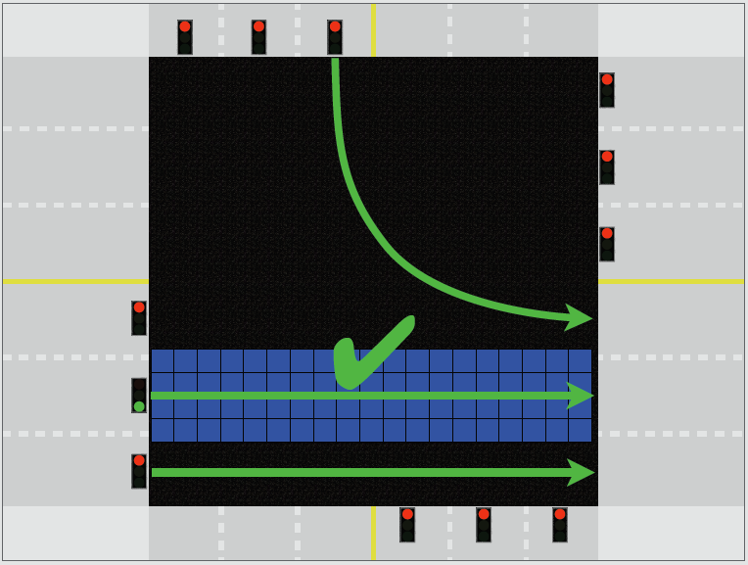
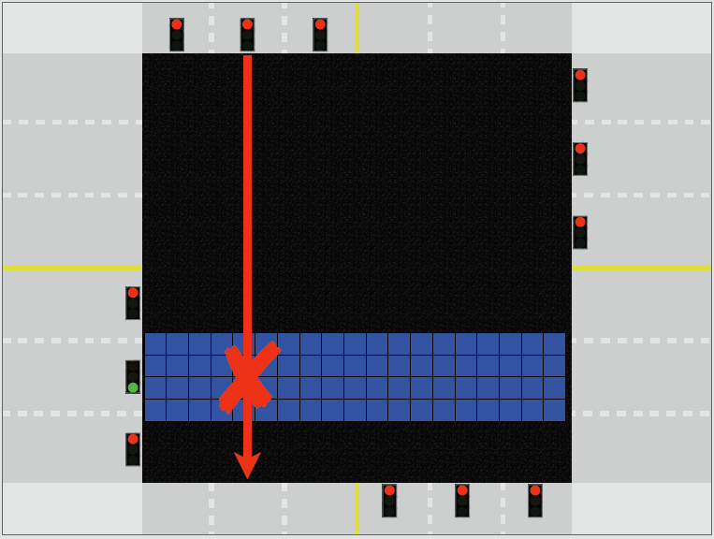
The FCFS-Light Policy
FCFS-Light = Traffic light + FCFS
Dresner and Stone, Human-Usable and Emergency Vehicle—Aware Control Policies for Autonomous Intersection Management, ATT 2006

Slide 15
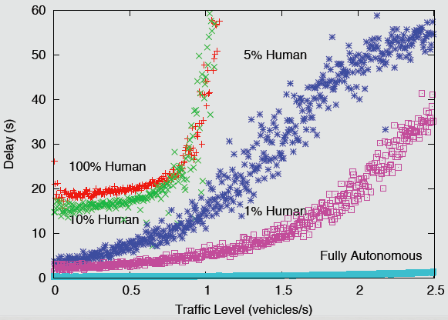
Gradual Adoption of AIM

Slide 16
Outline
An introduction to AIM
A platform for evaluating the AIM protocol using real autonomous vehicles.
Identify factors that affect the efficiency of AIM
Methods for improving the throughput of AIM.
Notes:
Need related work

Slide 17
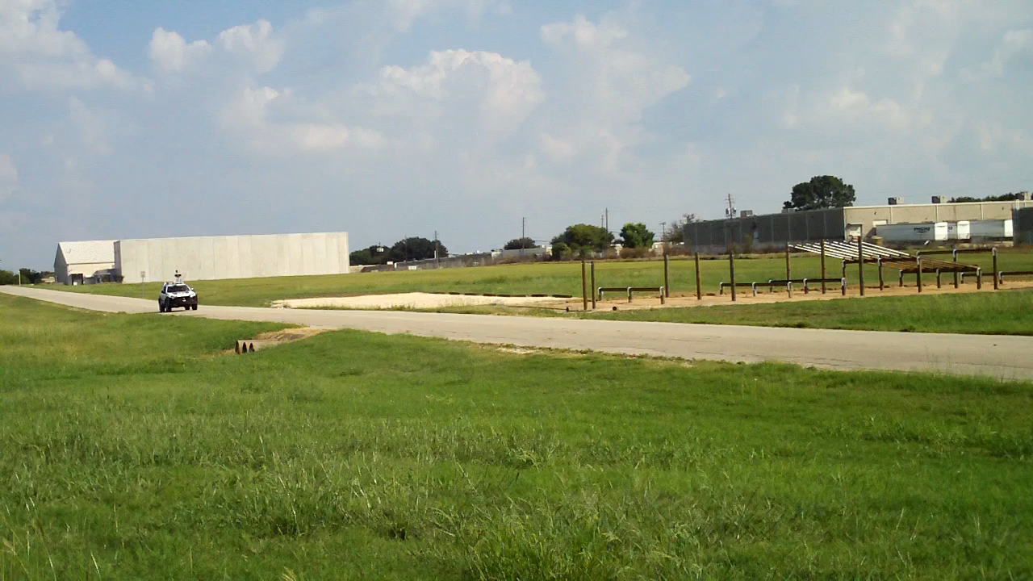
Marvin – Our Autonomous Vehicle

Slide 18
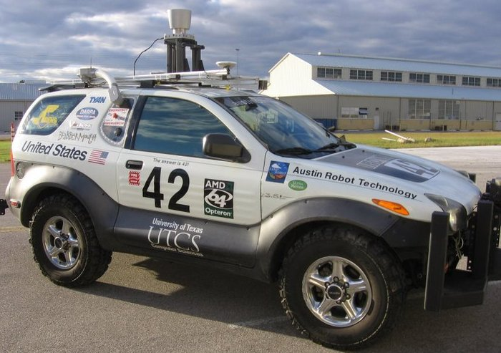
Mixed Reality Platform
Completely testing AIM on real hardware requires a fleet of autonomous vehicles
Expensive and dangerous!
We implemented a mixed reality platform
Testing a single (real) autonomous vehicle that interacts with many virtual (or simulated) vehicles.
Marvin – our autonomous vehicle

Slide 19
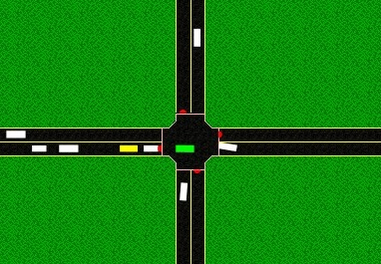
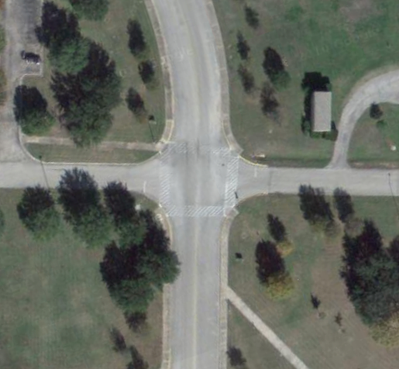
Mixed Reality Simulation Platform
Step 1: establish UDP network connection
Step 2: create the proxy vehicle
Proxy vehicle

Slide 20
Mixed Reality Simulation Platform
Step 3: constantly update the location, the direction, and the speed of the proxy vehicle
Proxy vehicle

Slide 21
Mixed Reality Simulation Platform
Step 4: sensing information collected by the proxy vehicle are forwarded to the real vehicle
Proxy vehicle

Slide 22
Mixed Reality Simulation Platform
Step 5: The real vehicle interacts with the intersection manager via the proxy vehicle
Proxy vehicle

Slide 23
Mixed Reality Platform
Physical State of the Vehicle
(GPS Location, Heading, Velocity, etc.)
Proxy vehicle
AIM Messages
(Request, Confirm, etc.)
Sensing Information
(Distance to the virtual vehicle in front, etc.)

Slide 24
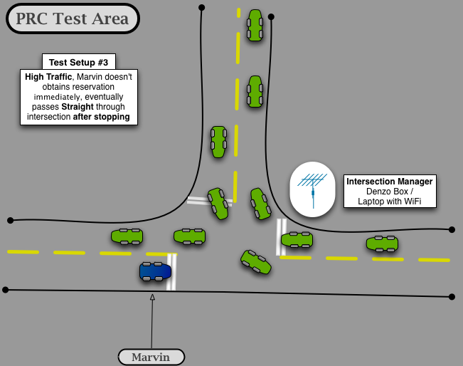
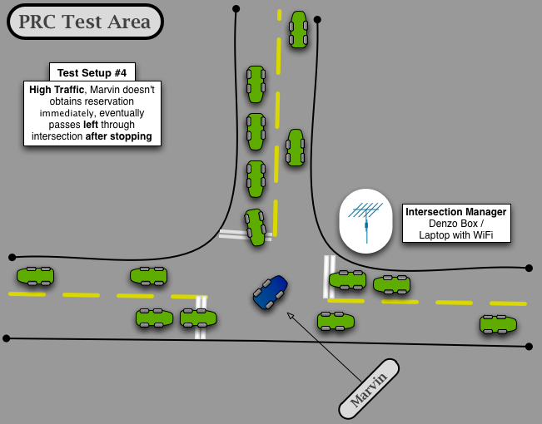
Experiment Setup at a T-junction

Slide 25
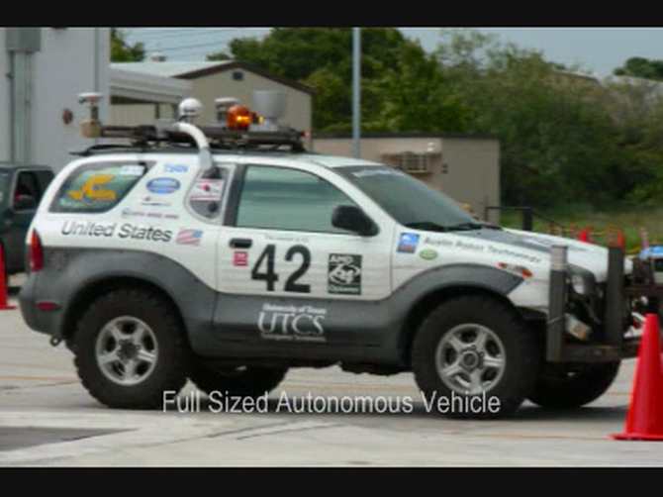
Mixed Reality in Action
Notes:
- the first part is just a demonstration of the car working at the Urban challenge with other real cars on the road, using a conventional stop sign.
- So note that a lot of time is wasted while each of the cars wait for each other.
Go to our web page to download the video.

Slide 26
Outline
An introduction to AIM
A platform for evaluating the AIM protocol using real autonomous vehicles.
Identify factors that affect the efficiency of AIM
Methods for improving the throughput of AIM.
Notes:
Need related work

Slide 27
What we learned from the reality check?
Identified areas in which previous simulations failed to capture the real-world performance of our autonomous vehicle
Sensing and control errors are much higher
Acceleration is slower
Maximum speed is lower
To safely traverse the intersection, Marvin needs
A larger buffer size
Lower acceleration and maximum speed
Notes:
Our previous simulations overly optimistic.

Slide 28
Simulation Parameters
Errors in the movement of the vehicle
Model the performance on the vehicle
Static buffer size
Time buffer size
Maximum acceleration
Maximum speed
Time 4
Time 3
Time 2
Time 1

Slide 29
The Effect of Increasing Static Buffer Size

Slide 30
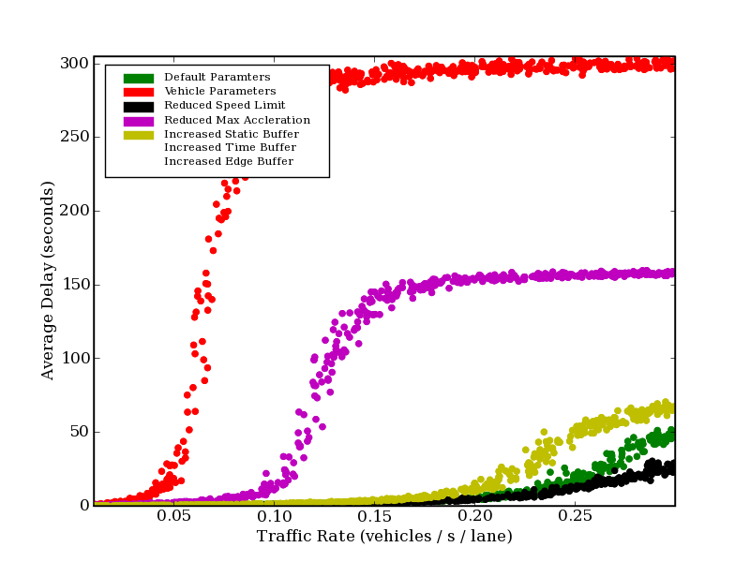
Using Realistic Simulation Parameters
In summary, the use of realistic simulation parameters decrease the performance of the protocol greatly.
Need to find ways to account for the larger buffer sizes and poorer vehicle’s performance.

Slide 31
Outline
An introduction to AIM
A platform for evaluating the AIM protocol using real autonomous vehicles.
Identify factors that affect the efficiency of AIM
Methods for improving the throughput of AIM.
Notes:
Need related work

Slide 32
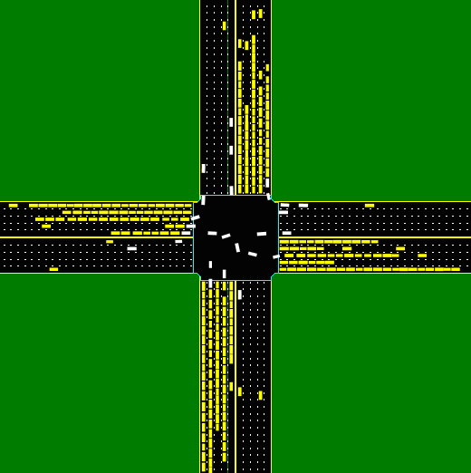
Traffic Congestion
Traffic congestion can still occur even in AIM.
Every intersection control mechanism has a maximum throughput
If traffic level > maximum throughput, traffic congestion occurs
How can we increase the maximum throughput of FCFS?

Slide 33
Little’s Law: N = λ T
N is the average number of vehicles inside the intersection
T is the average time a vehicle spends in the intersection
λ is the average arrival (entrance) rate of the vehicles at the intersection
λ is also the throughput of the intersection

Slide 34
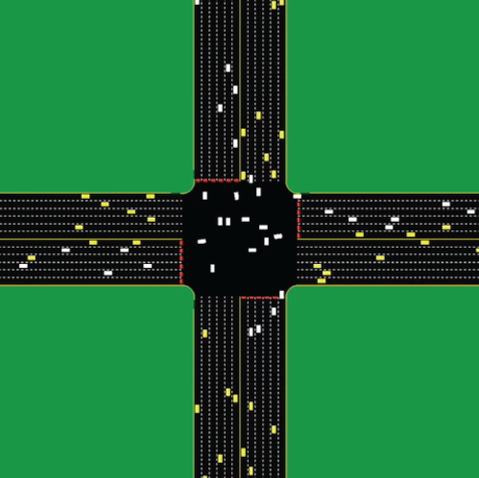
Maximum Throughput
The maximum throughput an intersection can sustain is the maximum of λ
The maximum of N = maximum number of vehicles coexist in the intersection.
The minimum of T = minimum average time a vehicles spend in the intersection

Slide 35
Increasing the Maximum Throughput
To increase the maximum throughput:
increase the maximum of N
decrease the minimum of T
It is hard to increase the maximum of N
area of intersection / min. size of vehicles
can’t push too many vehicles into the intersection at the same time
But there is a lot of room for reducing the minimum of T.
by increasing the speed of the vehicles, vehicles will spend less time in the intersection
The theoretical limit is the speed of light.

Slide 36
To Reduce Traversal Time…
The speed of a vehicle depends on:
The initial velocity when the vehicle enters the intersection.
The acceleration in the intersection.
To reduce traversal time…
Increase the arrival velocity
Increase the acceleration
Two predictions:
Preventing vehicles from stopping before entering an intersection can increase the throughput.
Increasing the acceleration can increase the throughput.

Slide 37
How to Prevent Stopping Before Intersection
Method 1: Obtain an accurate estimation of the arrival time and arrival velocity.
Poor estimation → unable to reach the intersection at the arrival time and the arrival velocity → cancel the reservation at the last moment before entering the intersection → stop before intersection
I‘m late and/or unable to get up to speed
You should have cancelled the reservation earlier.

Slide 38
How to Prevent Stopping Before Intersection
Method 2: Cancel reservation if the vehicle knows that it can’t arrive at the intersection at the given time and the given velocity.
Early cancellation→ can submit a new request as soon as possible
Early cancellation→ free up space-time tiles in the intersections
Can you arrive at time t_{end} and at velocity v_{end}?
No, I can’t

Slide 39
Method 1: Better Estimation of Arrival Time and Arrival Velocity
Make sure that the proposed arrival time and velocity is achievable.
i.e., there exists a sequence of control signals such that the vehicle, if follows the control signals correctly, will reach the intersection at the arrival time and velocity.
Formulate the estimation task as a multi-objective optimization problem:
Among all possible sequences of control signals, find one such that
the arrival velocity v_{end} is the highest, and
the arrival time t_{end} is the smallest.
I’m confident I can arrive at time t and at velocity v

Slide 40
The Sequence of Control Signals
For velocity-based controllers
velocity schedule v(·) - the velocity of the vehicle at any time in [t₁, t_{end}]
For acceleration-based controllers
acceleration schedule a(·) - the acceleration of the vehicle at any time in [t₁, t_{end}]
If a(·) is a piece-wise linear function,
a(·) = <(t₁,a₁), (t₂,a₂), … , (t_{end},a_{end})>
At time t₁, set
accel. to a₁
At time t₂, set
accel. to a₂
At time t₃, set
accel. to a₃
At time t_{end}, set
accel. to a_{end}

Slide 41
The Optimization Problem
Given
The current time t₁ and the current velocity v₁
The distance D between the current position and the intersection
The speed limit of the road v^{max}
The speed limit of the trajectory at the intersection v_{endmax}
The maximum acceleration a_{max} and the minimum acceleration a_{min}
Find a velocity schedule v(·) or an acceleration schedule a(·) such that v_{end} is maximized while t_{end} is minimized
At time t₁, the velocity is v₁
My max. accel. is a_{max}
My max. decel. is a_{min}
At time t_{end}, the velocity is v_{end}
SPEED
LIMIT
SPEED
LIMIT
v^{max}
v_{endmax}
D

Slide 42
The Time-Velocity Diagram
The function in the diagram is a velocity schedule v(·)
The visualization of constraints:
The velocity cannot exceed the speed of the road v^{max} or be negative at any time.
The arrival velocity v_{end} cannot exceed the speed limit at the trajectory v_{endmax.}
The acceleration at any point in time must be within the limitations [a_{min}, a_{max}].
The travel distance is D.
Velocity
v^{max}
a_{min} ≤ slope ≤ a_{max}
v_{end} < v_{endmax}
v(t)
v₁
D
0
Time
t₁
t_{end}

Slide 43
Optimal Velocity Schedule when v₁ ≤ v_{endmax}
Case 1:
D > Area₁ + Area₂
v_{end} = v_{endmax}
Case 2:
Area₁ + Area₂ ≥ D > Area₃
v_{end} = v_{endmax}
Case 3:
D = Area₃
v_{end} = v_{endmax}
Case 4:
Area₃ > D ≥ 0
v_{end} < v_{endmax}
Velocity
Velocity
Velocity
Velocity
v^{max}
v^{max}
v^{max}
v^{max}
v_{endmax}
v_{endmax}
v_{endmax}
v_{endmax}
v₁
v₁
v₁
v₁
Area₁
Area₂
Area₃
0
Time
0
Time
0
Time
0
Time
t₁
t_{end}
t₁
t_{end}
t₁
t_{end}
t₁
t_{end}
Always have a solution
When D ≥ Area₃ , always arrive at the intersection at the maximum arrival speed v_{endmax} in the smallest amount of time
When D < Area₃ , arrive at the intersection at the highest velocity (< v_{endmax}) in the smallest amount of time

Slide 44
Optimal Velocity Schedule when v₁ > v_{endmax}
Case 1:
D > Area₁ + Area₂
v_{end} = v_{endmax}
Case 2:
Area₁ + Area₂ ≥ D > Area₃
v_{end} = v_{endmax}
Case 3:
D = Area₃
v_{end} = v_{endmax}
Case 4:
Area₃ > D ≥ 0
No solution
Velocity
Velocity
Velocity
Velocity
v^{max}
v^{max}
v^{max}
v^{max}
v₁
v₁
v₁
v₁
v_{endmax}
v_{endmax}
v_{endmax}
v_{endmax}
Area₁
Area₂
Area₃
0
0
Time
0
0
Time
Time
Time
t₁
t_{end}
t₁
t_{end}
t₁
t_{end}
t₁
t_{end}
No solution when D < Area₃, because the vehicle is close to the intersection---can’t decelerate enough to a velocity below v_{endmax}
When D ≥ Area₃ , always arrive at the intersection at the maximum arrival speed v_{endmax} in the smallest amount of time

Slide 45
Guarantee arriving at the right time and at the right speed
The algorithm returns the optimal arrival time t_{end} and optimal arrival velocity v_{end} together with the velocity schedule (or acceleration schedule)
avoid cancellation of reservation → avoid stopping before intersection
I will be on time and at the right speed
Then I expect no cancellation

Slide 46
Method 2: Early Cancellation
Method 2: Cancel reservation if the vehicle knows that it can’t arrrive at the intersection at the given time and the given velocity.
Early cancellation→ can submit a new request as soon as possible
Early cancellation→ free up space-time tiles in the intersections
Can you arrive at time t_{end} and at velocity v_{end}?
No, I can’t

Slide 47
The Validation Problem
Given
The current time t₁ and the current velocity v₁
The arrival time t_{end} and the arrival velocity v_{end} (assume v_{end} ≤v_{endmax})
The distance D between the current position and the intersection
The speed limit of the road v^{max}
The maximum acceleration a_{max} and the minimum acceleration a_{min}
Check whether a velocity schedule v(·) or an acceleration schedule a(·) exists such that the vehicle can arrives at the intersection at the given t_{end} and the given velocity v_{end}
At time t₁, the velocity is v₁
My max. accel. is a_{max}
My max. decel. is a_{min}
At time t_{end}, the velocity is v_{end}
SPEED
LIMIT
SPEED
LIMIT
v^{max}
v_{endmax}
D

Slide 48
The Time-Velocity Diagram
The visualization of the constraints:
v(t₁) = v₁ and v(t_{end}) = v_{end}
The velocity cannot exceed the speed of the road v^{max} or be negative at any time
The arrival velocity v_{end} cannot exceed the speed limit of the trajectory v_{endmax}
The acceleration at any point in time must be within the limitations [a_{min}, a_{max}]
The travel distance is D
Velocity
v^{max}
a_{min} ≤ slope ≤ a_{max}
v_{end} < v_{endmax}
v(t)
v₁
D
0
Time
t₁
t_{end}

Slide 49
The Liquid Metaphor
Satisfied all constraints except the travel distance constraint D
Velocity
v^{max}
slope = a_{max}
slope = a_{min}
v_{end} < v_{endmax}
v(t)
v₁
D
0
Time
t₁
t_{end}

Slide 50
The Liquid Metaphor
Satisfied all constraints except the travel distance constraint D
Velocity
v^{max}
slope = a_{max}
slope = a_{min}
Area₃
v_{end} < v_{endmax}
Area₂
v₁
Area₁
Area_{R}
Area_{L}
0
Time
t₁
t_{end}

Slide 51
Feasible and Infeasible Cases
Case 1:
Case 2:
Case 3:
Infeasible cases
Case 4: D < Area_{L} + Area_{R}
Case 5: Area_{L} + Area_{R} + Area₁ + Area₂ + Area₃ < D

Slide 52
Guarantee Early Cancellation of Reservations
The algorithm returns true if and only if an acceleration schedule exists for arriving at the intersection at the given time and the given velocity.
In the infeasible cases, cancel the reservation as early as possible
In the feasible cases, the acceleration schedule can be used to control the vehicle.
No, I can’t
Can you arrive at time t_{end} and at velocity v_{end}?

Slide 53
Planning-Based Controllers vs. Heuristic-Based Controllers
Conducted an experiment to compare with the previous vehicle controller.
Heuristic-Based
Controller
Planning-Based
Controller

Slide 54
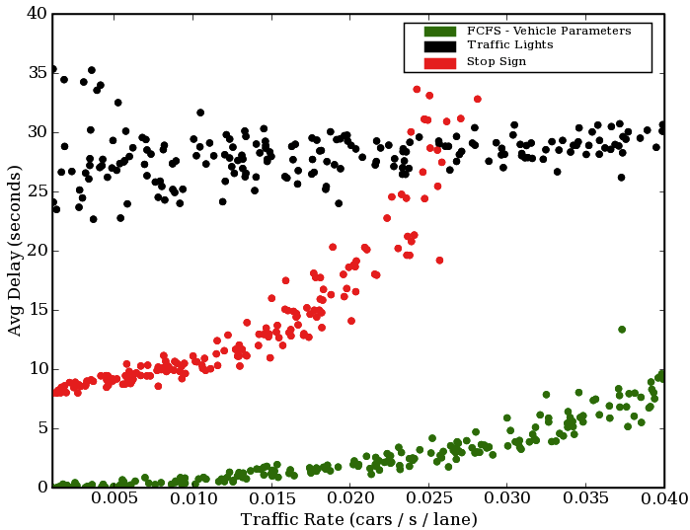
AIM vs. Signs and Traffic Signals
With the help of the motion planning algorithms, AIM is still better than stop signs and traffic signals when realistic simulation parameters are being used.

Slide 55
Increasing Throughput by Increasing Acceleration
Increasing acceleration can reduce the traversal time of the vehicles.
especially when many vehicles have stopped before the intersection
An increase of acceleration can increase the throughput
Acceleration↑ → Speed ↑ → Time (T) ↓ → Throughput (λ)↑
Intuitively, the trajectory of fast moving vehicles reserves less tiles in the reservation grid
The intersection can handle more trajectories.

Slide 56
Acceleration vs. Throughput
Traffic level = 0.16 vehicles / second / lane
λ
a
a
The throughput (λ) is approximately proportional to the square root of the acceleration (a).

Slide 57
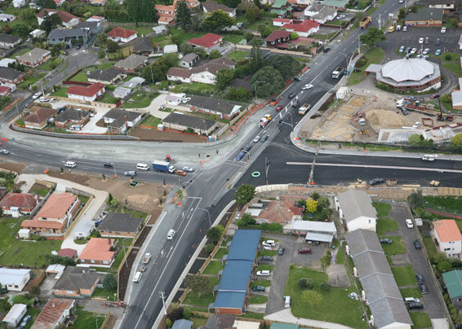
Conclusions
The mixed reality platform.
Realistic simulation parameters.
Analysis of the relationship between the maximum throughput and the vehicle’s performance.
Motion planning algorithms.
Notes:
Realistically evaluated the AIM protocol.
Little’s Law: Prevent stopping before intersections and increase acceleration.
Motion planning techniques to prevent stopping before intersections.
Conducted experiments to evaluate the planning-based controllers and the acceleration.

Slide 58
Future Work
Implement the motion planning algorithms on Marvin.
Optimization of reservations
Network of Intersections
Partially autonomous vehicles
Adaptive cruise control
Autonomous parallel parking
Traffic sign recognition
Lane departure warning systems

Slide 59


My Other Work
Non-zero-sum, repeated games
How to cope with errors in the intersection among agents
Learning from intersection traces
AI planning
HTN planning
Planning with violate, external information
Case-based reasoning
Reuse of previous problem solving experience
Derivational analogy
Iterated Prisoner’s Dilemma
Agent₁
Agent₂
Interaction
Traces
Opponent
Agent₃

Slide 60
Thank you!
Any Questions?

